Slide 1
University of Toronto Data Visualization Boot Camp: FACTORS IMPACTING CONSUMER SPENDING ON AIRBNB IN New York City
Alyshia Kiczma
Arshdeep Khurana
Nasir Qadri
Kaylyn Valdez-Scott

Slide 2
Project description
Our team was hired by Airbnb to analyze various factors and determine any impacts on customer spending

Slide 3
Questions of Interest
Do different neighbourhoods or neighbourhood groups differ in price?
Does the verification of the host impact the price of the listing?
Does Construction year of the property impact the price of the listing?
How prevalent are cancellation policies and do they impact the listing?
Do number of reviews differ based on room type? Does the review rate number impact the price?

Slide 4
Data set
https://www.kaggle.com/datasets/arianazmoudeh/airbnbopendata?select=Airbnb_Open_Data.csv

Slide 5
Initial data cleanup

Slide 6
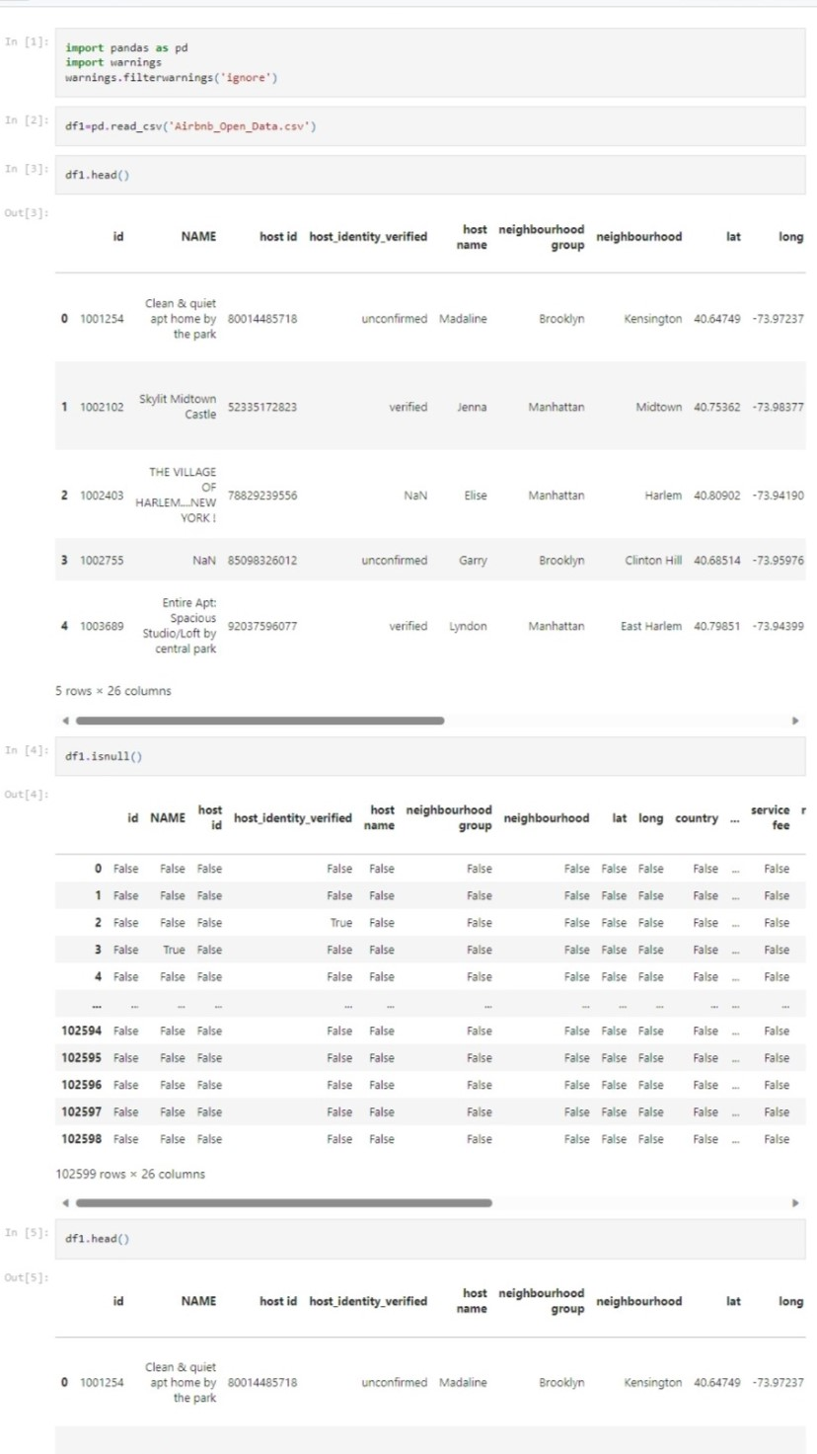
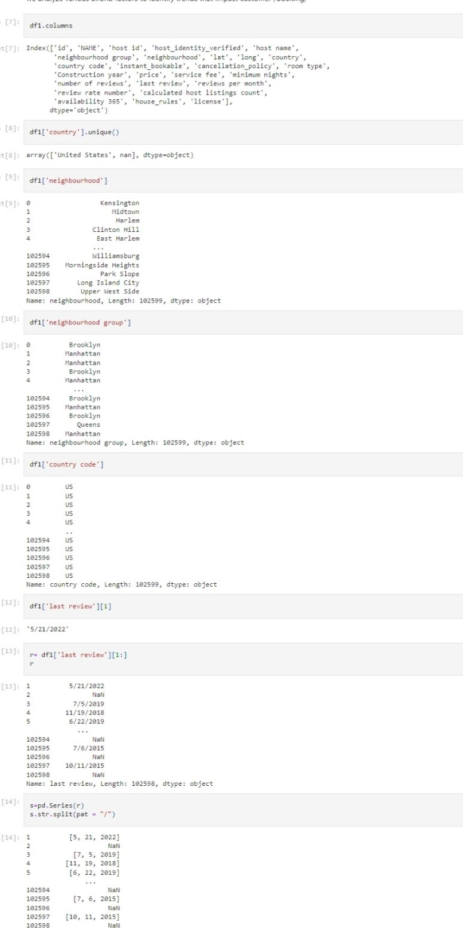

Slide 7
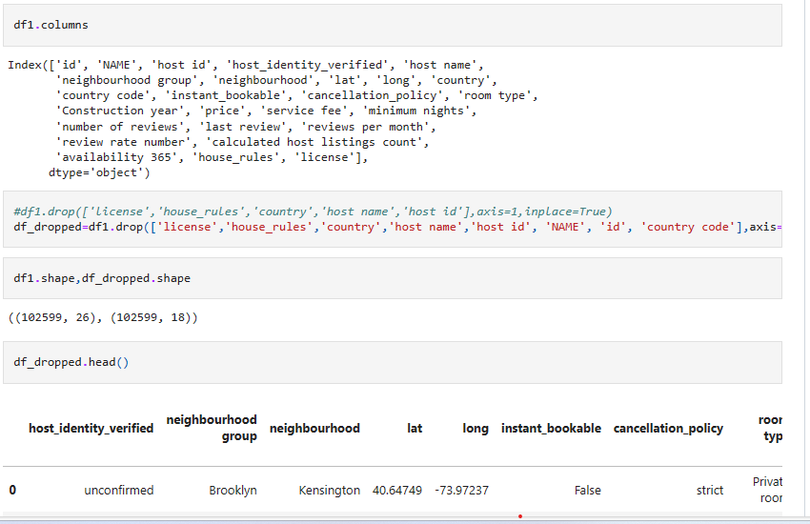
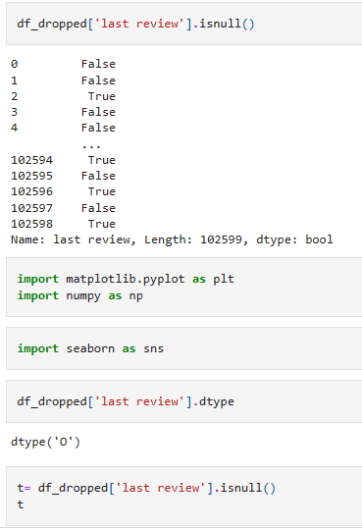
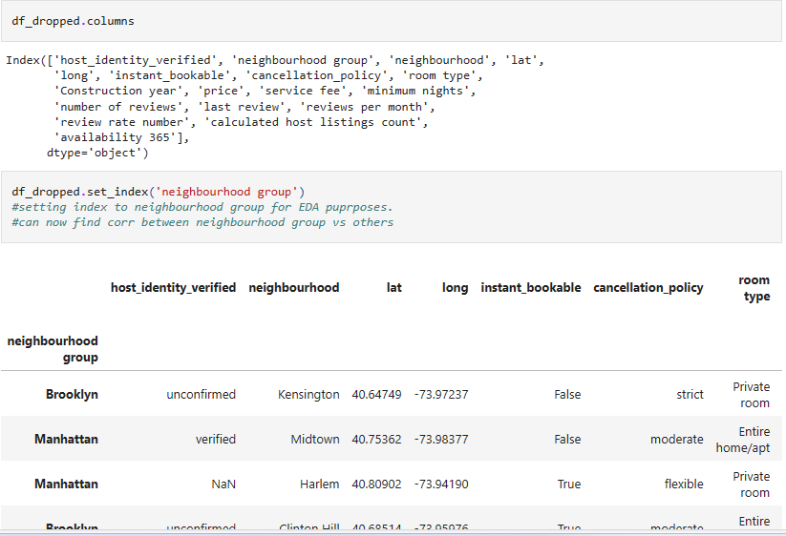

Slide 8
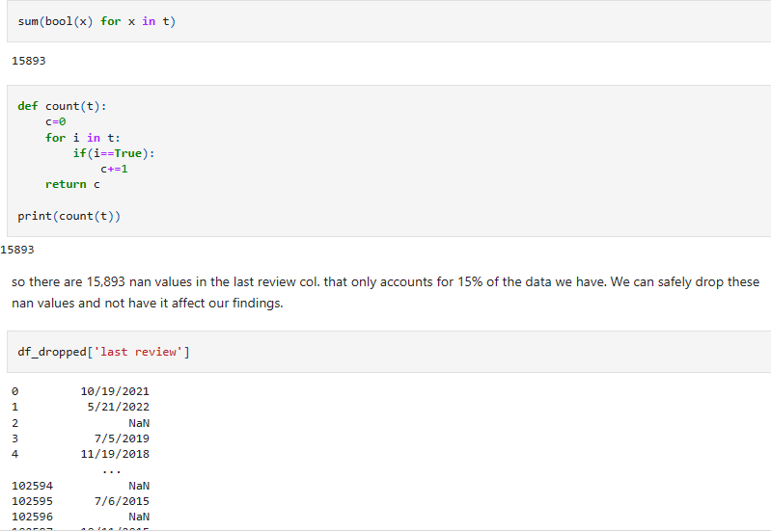
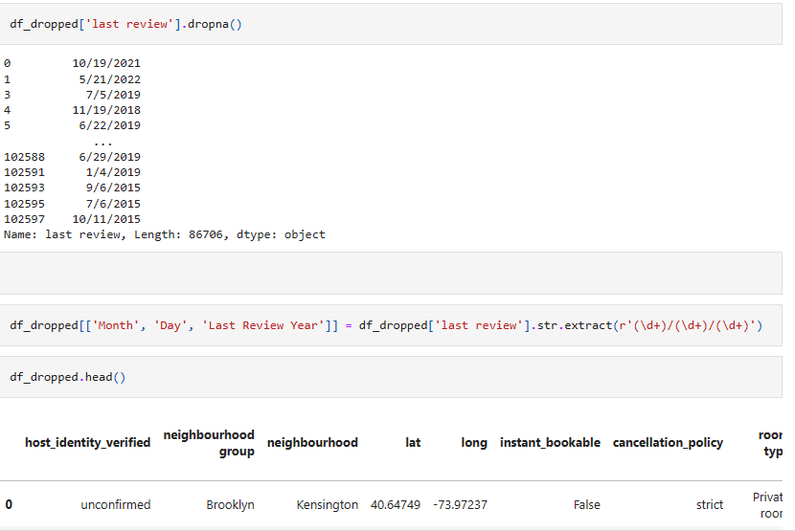

Slide 9
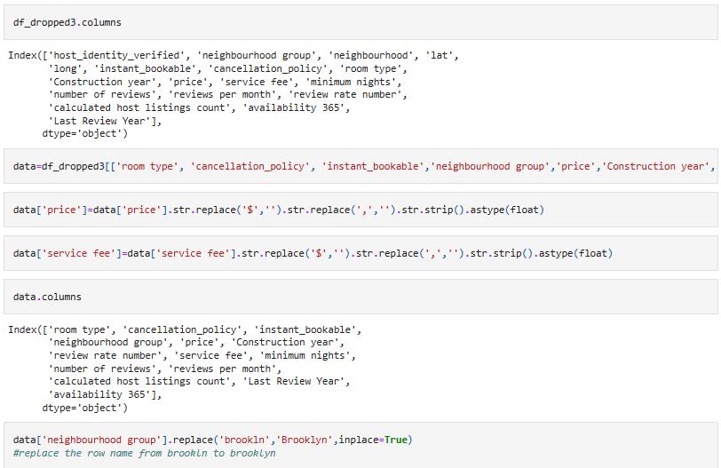

Slide 10
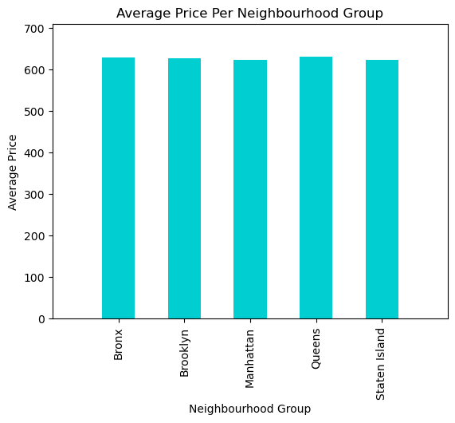
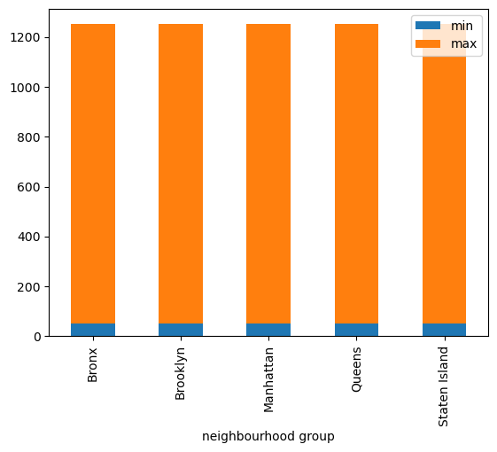
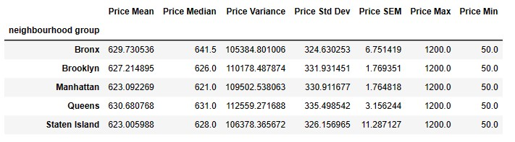
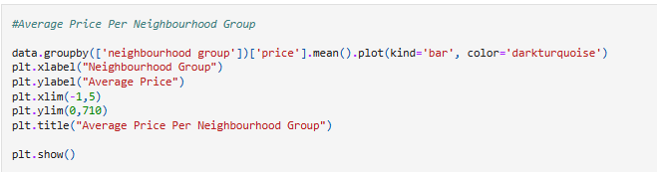
Do different neighbourhoods or neighbourhood groups differ in price?
df3.groupby('neighbourhood group')['price'].agg(['min','max']).plot(kind='bar',stacked=True)

Slide 11
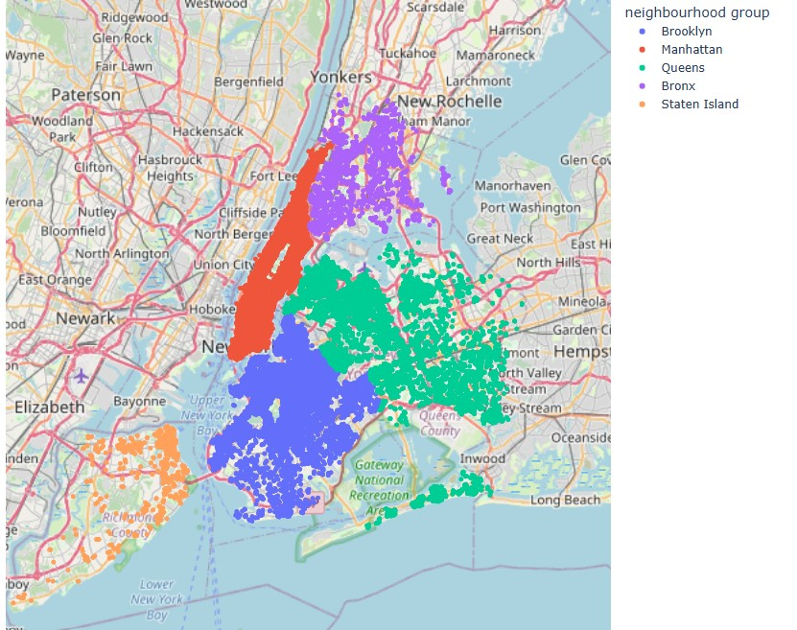
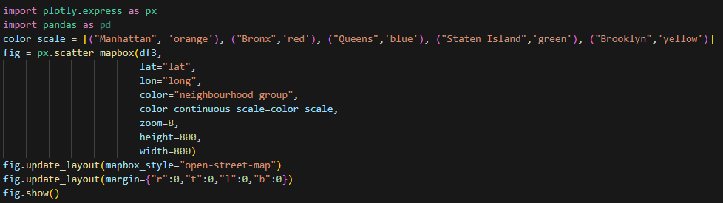
Listing volume by neighbourhood group

Slide 12
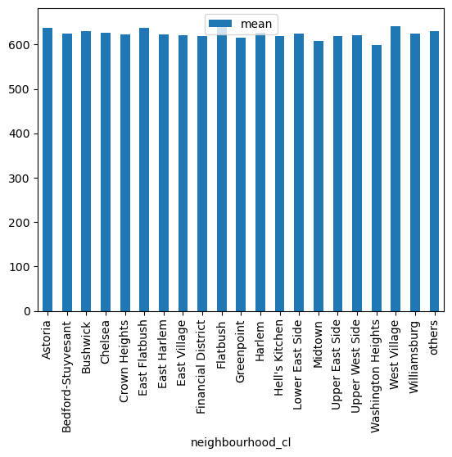
Do different neighbourhoods or neighbourhood groups differ in price?

Slide 13
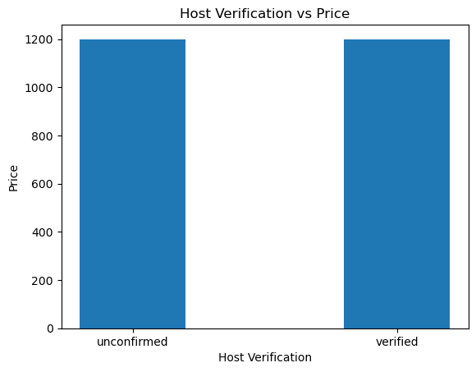

Does having a verified host impact price?

Slide 14
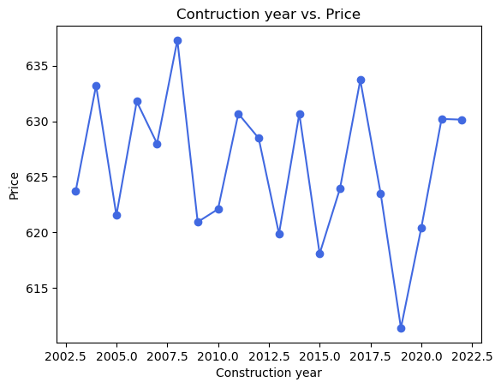
Does construction year impact price
Construction Year Median | Construction Year Variance | Construction Year Std Dev | Construction Year SEM | Construction Year Max | Construction Year Min
2012 | 34.373862 | 5.862923 | 0.121933 | 2022 | 2003
2013 | 33.145421 | 5.757206 | 0.030689 | 2022 | 2003
2012 | 32.878289 | 5.733959 | 0.03058 | 2022 | 2003
2012 | 34.023267 | 5.832947 | 0.054874 | 2022 | 2003
2011 | 34.271451 | 5.854182 | 0.202592 | 2022 | 2003
2010 | NaN | NaN | NaN | 2010 | 2010

Slide 15
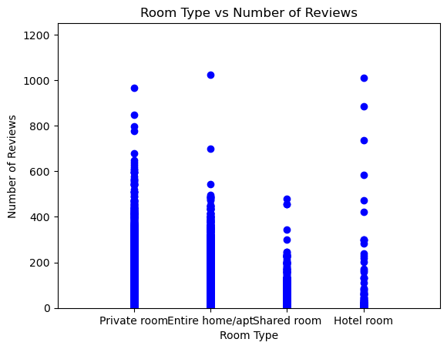
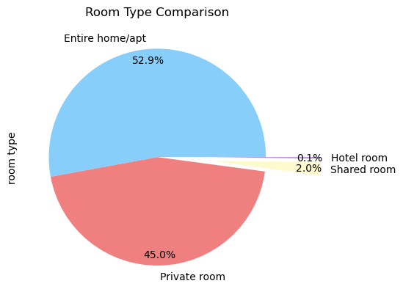
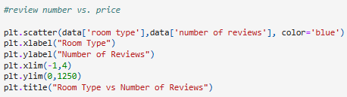

Room Type

Slide 16
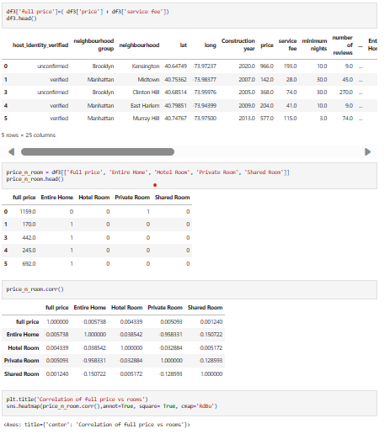
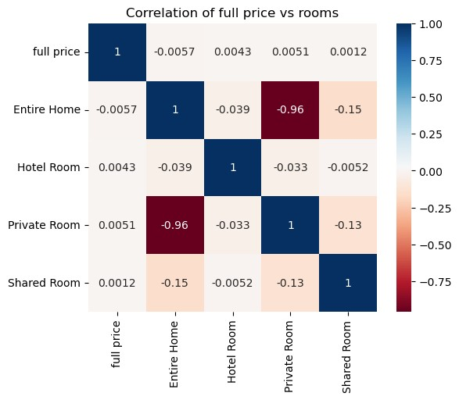
Price vs. Room type

Slide 17
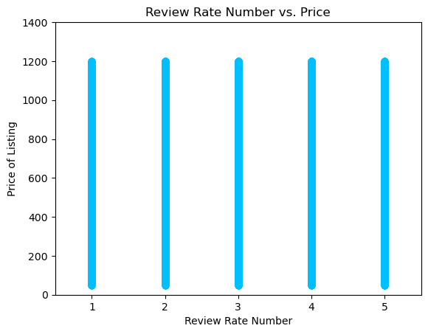
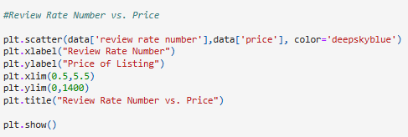
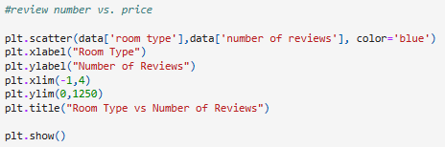
do number of reviews differ based on room type?

Slide 18
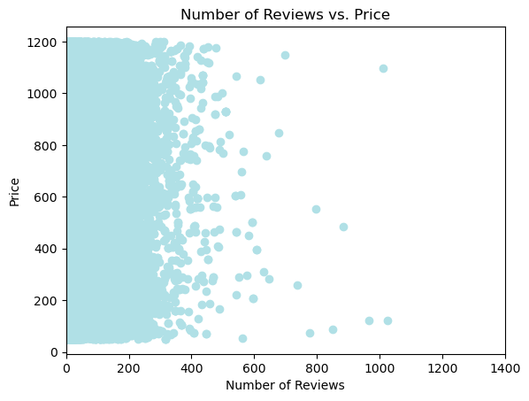
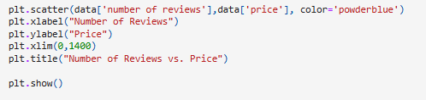
Does the review rate number impact the price?

Slide 19
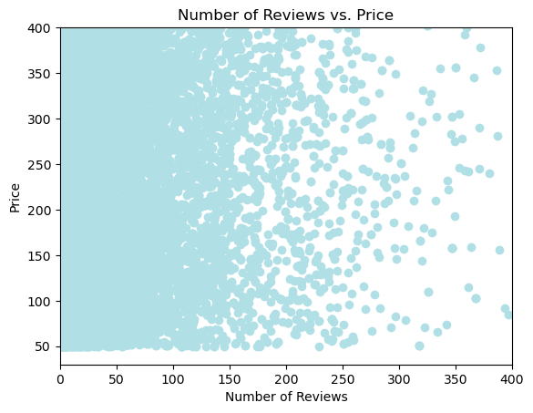
Does the review rate number impact the price?

Slide 20
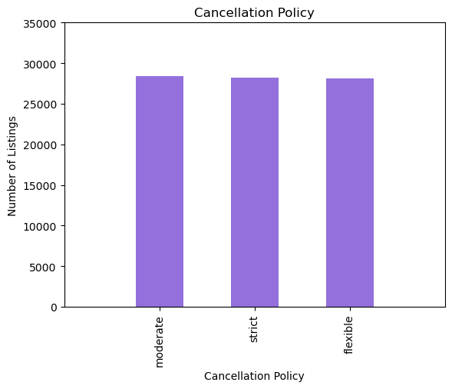
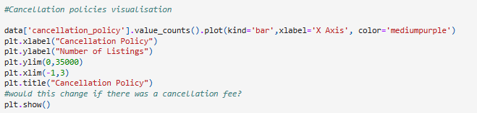
How prevalent is a cancellation policy?

Slide 21
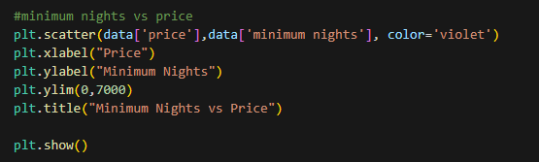
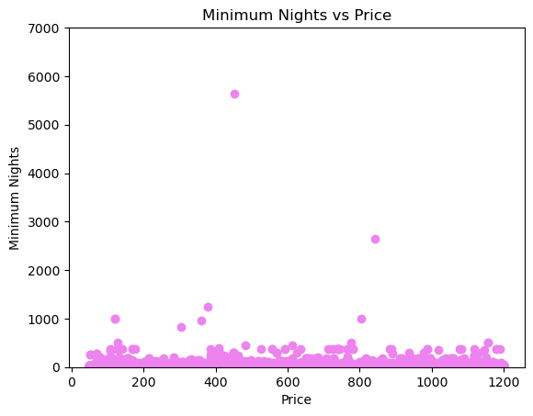
Do Minimum Nights of a Listing impact the price

Slide 22
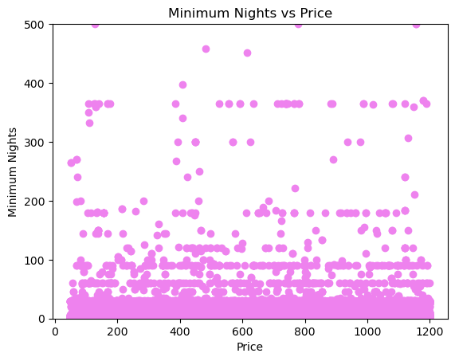
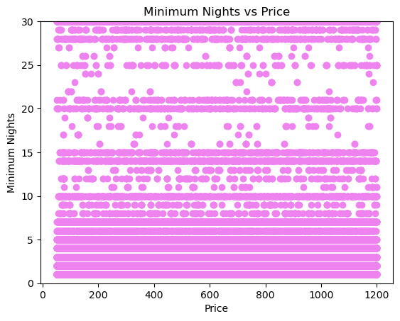
Do Minimum Nights of a Listing impact the price

Slide 23
Further investigation
Are bookings for various room types impacted by whether host is male vs female?
Does host language preference impact client preference for booking?
Does the cancellation policy impact the rate of booking for the listing?
Is there a correlation between cancellation policy and whether there is a cancellation fee?

Slide 24
conclusion
Contrary to our initial expectations, there are no clear correlations between the data and the factors that were investigated in this project.
Further analysis required of various factors to gain an understanding of any trends or correlations.

Slide 25
Thank you for listening!

